Slide 1

Data Structures
Graphs
Ingrid Kirschning

Slide 2
Graphs
6.1 Definition.
6.2 Undirected Graphs.
6.3 Directed Graphs.
6.4 TRIE.

Slide 3
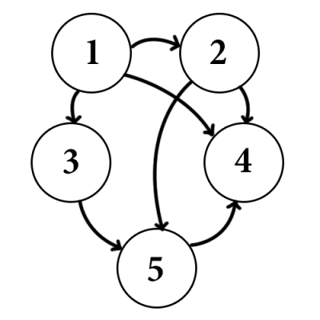
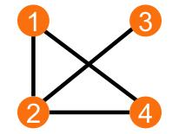
Graphs
A network of lines connecting points.
A diagram representing a system of connections or interrelations among two or more things, as by a number of distinctive dots or lines.

Slide 4
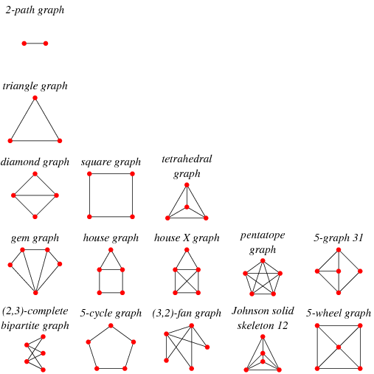
Examples of graphs
http://mathworld.wolfram.com/BiconnectedGraph.html

Slide 5
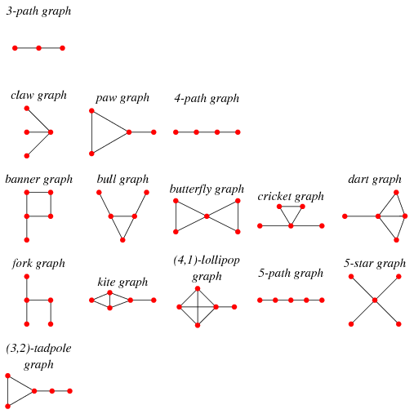
Examples of graphs
http://mathworld.wolfram.com/BiconnectedGraph.html

Slide 6
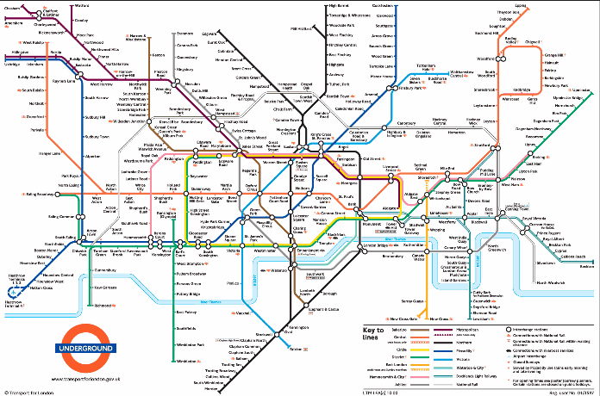

Slide 7
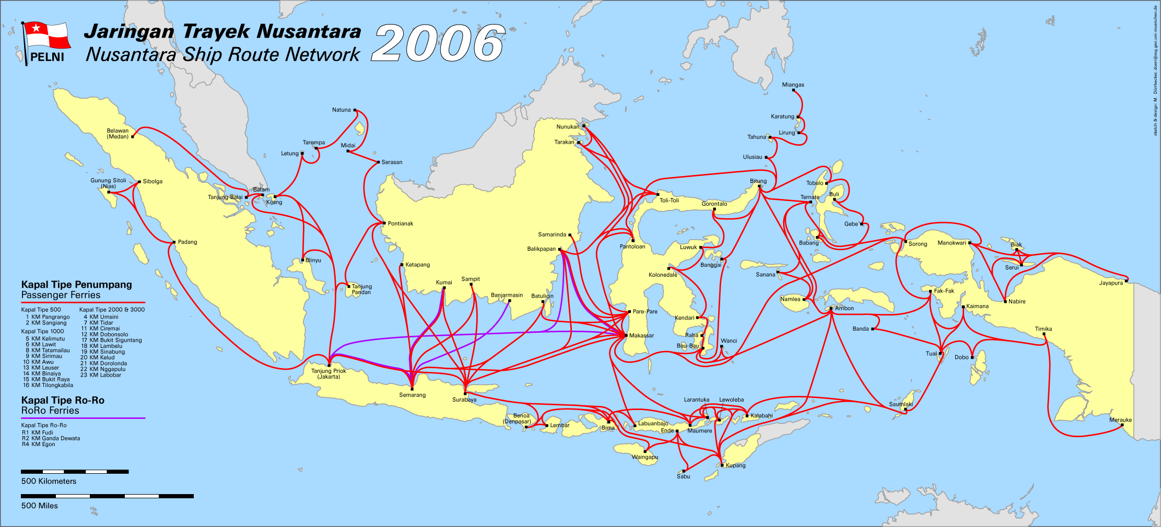

Slide 8
Graphs
Graphs consist of two sets: a set of nodes and a set of arcs that connect nodes.
An arc a connects 2 adyacent nodes u and v: a = (u,v)
Degree of a node: is the number of arcs leaving a node
Graphs can be directed (each arc has a specific direction, indicated by an arrow) or undirected.

Slide 9
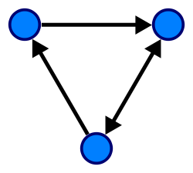
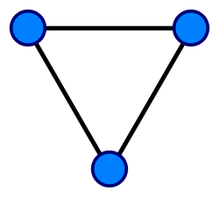
Undirected Graph
A directed graph.
A simple undirected graph with three vertices and three edges. Each vertex has degree two, so this is also a regular graph.

Slide 10
Clases of Directed Graphs
A symmetric graph is a directed graph in which for every arrow that belongs to it, the corresponding inversed arrow also belongs to it.
A symmetric, loopless directed graph is equivalent to an undirected graph with the edges replaced by pairs of inversed arrows; thus the number of edges is equal to the number of arrows halved.

Slide 11
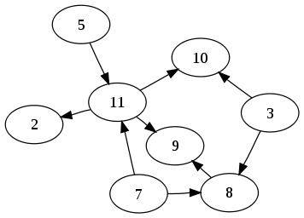
An directed acyclic graph is a directed graph with no directed cycles.
Special cases include:
multitrees (no two directed paths from a single starting vertex meet back at the same ending vertex),
oriented trees or polytrees (directed graphs formed by orienting the edges of undirected acyclic graphs), and
rooted trees (oriented trees in which all edges of the underlying undirected tree are directed away from the roots).

Slide 12
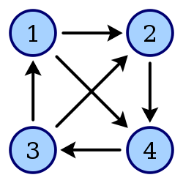
A tournament is an oriented graph in which every pair of distinct vertices is connected by a single directed edge.
Labels: the arcs in graphs usually
are labeled, showing some kind
of information, such as the cost to traverse that arc ($, distance, etc.)

Slide 13
Traversing graphs
When working with graphs, it is common to search a way to reach point B, starting at point A, considering certain conditions, for example:
What is the shortest path?
What is the cheapest way?
Whisch is the shortest way within a budget of $ X?
The algorithms most used for directed graphs are Dijkstra, Floyd and Warshall.
Other algorithms used to find spanning trees the include all nodes at the least cost, such as Prim and Kusrkal.
But there are many other heuristic methods that accomplish the task with reasonable results.

Slide 14
Search Methods
The search methods are defined by the way they proceed, and they are called:
Depth-first search (DFS) (see https://www.cs.usfca.edu/~galles/visualization/DFS.html )
Breadth-first search (see https://www.cs.usfca.edu/~galles/visualization/BFS.html )
Breadth-First: it means we visit all a node’s neighbours before we visit the neighbours' neighbours.
Depth-First: The idea is to travel as deep as possible from neighbour to neighbour before backtracking. What determines how deep it is possible is that you must follow edges, and you don't visit any vertex twice.

Slide 15
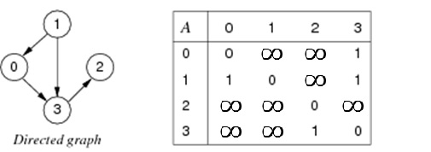
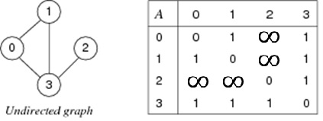
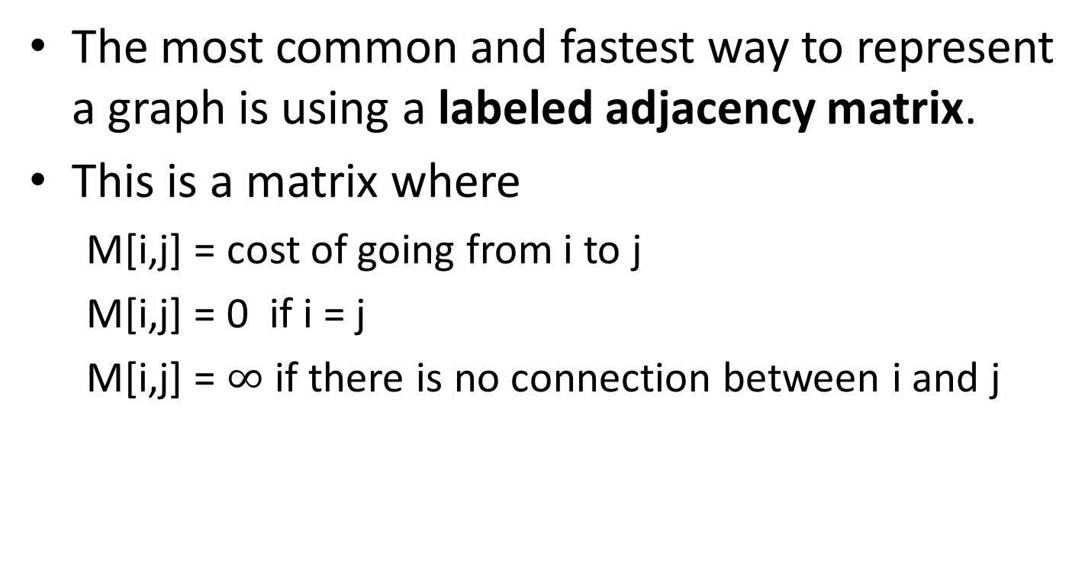
Representing a graph
The most common and fastest way to represent a graph is using a labeled adjacency matrix.
This is a matrix where
M[i,j] = cost of going from i to j
M[i,j] = 0 if i = j
M[i,j] = $∞$ if there is no connection between i and j

Slide 16
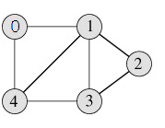
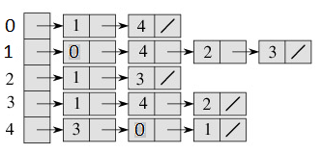
Representing a graph
Another way to represent a graph is using a Linked List – version
See also https://www.khanacademy.org/computing/computer-science/algorithms/graph-representation/a/representing-graphs
http://www.geeksforgeeks.org/graph-and-its-representations/

Slide 17
Dijkstra's algorithm
Dijkstra's algorithm is an algorithm for finding the shortest paths between nodes in a graph, which may represent, for example, road networks.
It was conceived by computer scientist Edsger W. Dijkstra in 1956 and published three years later.
The algorithm exists in many variants; Dijkstra's original variant found the shortest path between two nodes, but a more common variant fixes a single node as the "source" node and finds shortest paths from the source to all other nodes in the graph, producing a shortest path tree.
https://en.wikipedia.org/wiki/Dijkstra%27s_algorithm

Slide 18
Trie Structure
A TRIE (pronounced as in "try") is escentially a n-ary tree.
(Note: n-ary means that n is the máximum number of children of a node, for example, for n = 2 the tree is called binary)
A difference betrween Tries and the trees seen previoulsy is that in the other trees each key was stored as one complete ítem and a serach compared the complete key. In a Trie, also known as digital trees, the keys are decomposed into a sequence of symbols.
Tries are part of the Multiway trees, and are useful when a search has to be donde symbol by symbol.
They are also useful when the keys share the same prefix, this allows us to sabe storage space.

Slide 19
TRIE
Every node of the trie is a state to which we arrive by traversing an arc that corresponds to the symbol we are searching.
To avoid confusión between keys that share a prefix, such as “BAT" and “BATMAN" we use a special symbol to indicate the end of a key '#‘. This way no prefix can be considered in itself a key unless it includes the end of string marker.
In other words: the complete path from the root to a descending leaf (where the last symbol of the sequence is ‘#’ corresponds to one key.

Slide 20
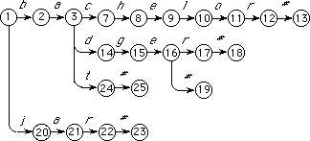
Example of a TRIE
Trie structure for the keys: bachelor#, badger#, badge#, bat#, and jar#.

Slide 21
Formalizong the Trie
K is the set of keys.
N is the finite set of nodes, represented by positive integers.
I is the finite set of symbols – all the symbols used in the keys.
g is the GOTO funtion that can return 2 results: the number of a valid state or 'fail' if no state can be reached with a specific symbol.
The first node (root) in N is always represented with the number 1.
F is a subset of N and correspondes to the terminal nodes.
I* denotes the set of all the symbols that are used as part of the keys , including the empty string.
g(n, a) = m is the goto function saying ther there is an arc from node n with the symbol a that leads to node m.
g(n, a) = fail indicates that no arc parting from n represents symbol a.

Slide 22
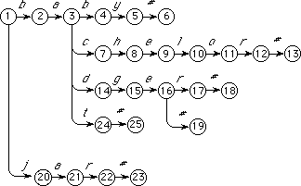
Example
K: {baby#, bachelor,#, badger#, bat#, badge#, jar#}
N: {1,2,3,4,5,…25}
I: {a, b, c, d, e, g, h, j, l, o, r, t, #}
F:{6, 13, 18, 19, 23}

Slide 23
Representing a Trie
Matrix
Linked List
Two-arrays
In both cases where the trie is represented in a matrix (adjacency matrix or two-arrays) the symbols in I have to be mapped to non-negative integers that do not include zero.

Slide 24
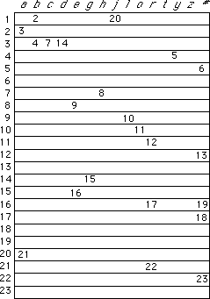
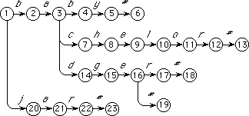
Matrix: columns = I, rows = N

Slide 25
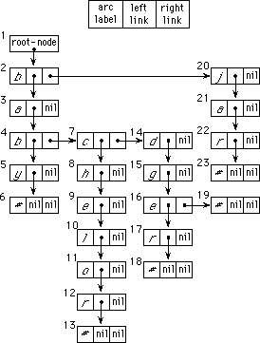
Linked List

Slide 26
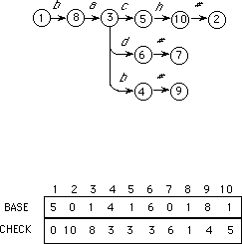
Two Arrays
Reduces significantly storage space
Requires much more processing, especially in the case of collisions.
Arrays
Base and Check:
BASE [n] + a = m
Like goto(n,a)=m
CHECK[m] = n

Slide 27
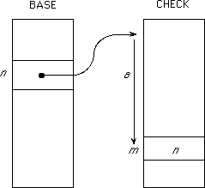
Two Arrays
BASE [n] + a = m
CHECK[m] = n

Slide 28
